Slide 1
LaunchCode Capstone Project
File created on: 10/24/2023 5:56:05 PM

Slide 2
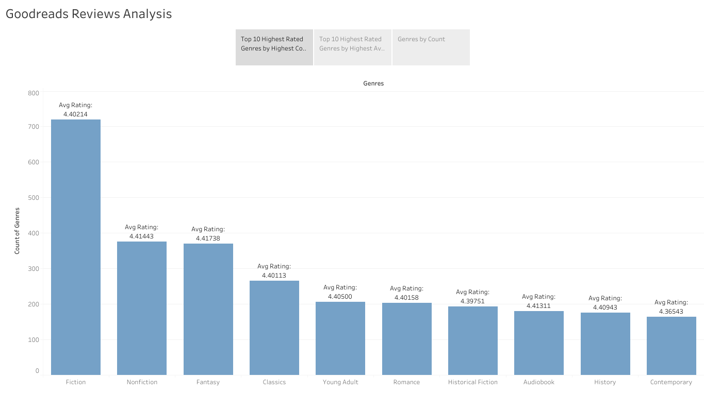

Slide 3
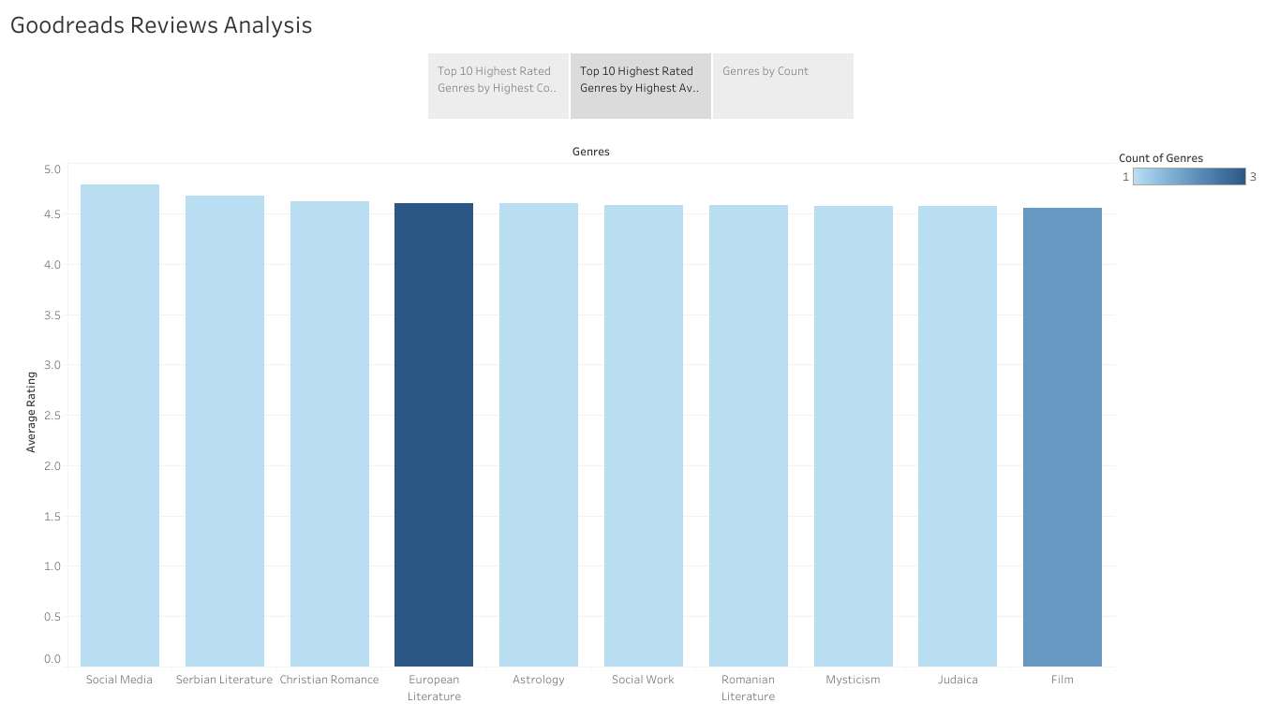

Slide 4
